Slide 1

ICE-PAC
Tracy Rausch, Founder, DocBox Inc
tracy@docboxinc.com
617.997.8375
Todd Cooper
President
Breakthrough Solutions Foundry

Slide 2
• ICE‐PAC is a joint working group between ASTM:
  Device in the Integrated the Clinical Environment
  Standard (ICE) and IHE PCD in order to analyze
  existing standards (IEEE 11073 and ASTM F29.21)
to explore standards gaps and profile roadmap
gaps.
• To produce requirements for standards at a systems level
• Identify hazards where clinical practice meets
engineering systems

Slide 3
Methodology
Clinical
Scenario
Clinical
Scenario
Clinical Scenarios
Clinical Concept of Operations
Clinicians
Clinical
Workflow
Graphical Workflow
General Systems Building
Blocks For Medical Systems
Workflow
Analysis
Activity Diagram
Interaction Diagram
Clinical Engineers
Risk
Analysis
State
Diagram
Design Engineers
All Medical Processes Made
Up of Systems Building Blocks
Technical
Solution and
Clinical
Implementation
IHE PCD DPI…

Slide 4
Requirements
Clinical
Scenario
Clinical
Scenario
Gathering Requirements from Clinical System
Providing Traceability of System Requirements
Provide Systems Level Risk Analysis
Provides Traceability to Mitigating Risk
Designing for the System, not modifying the system
causing unintended consequences
General Building Blocks and Interactions
between the blocks are key to Safety
If General Building Blocks make up Specific Systems
then Systems are safe
Clinicians
Clinical
Workflow
Workflow
Analysis
Clinical Engineers
Risk
Analysis
State
Diagram
Design Engineers
Technical
Solution and
Clinical
Implementation

Slide 5
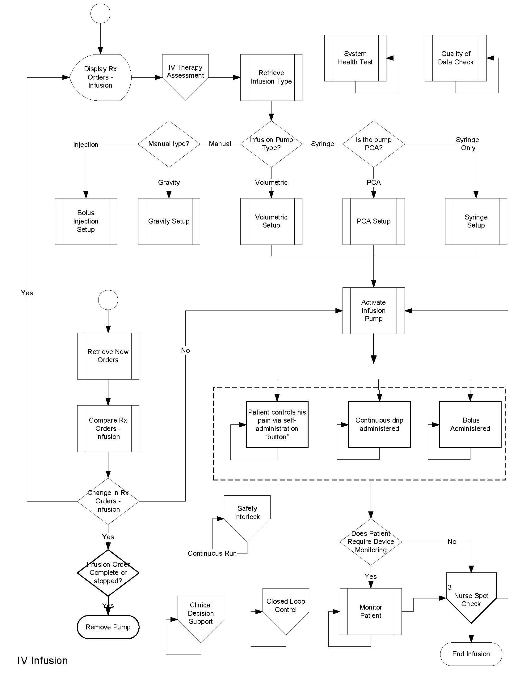
General Overview
Workflow of
All Infusion Therapies
Each Box is has at
least one additional
drilled down
page

Slide 6
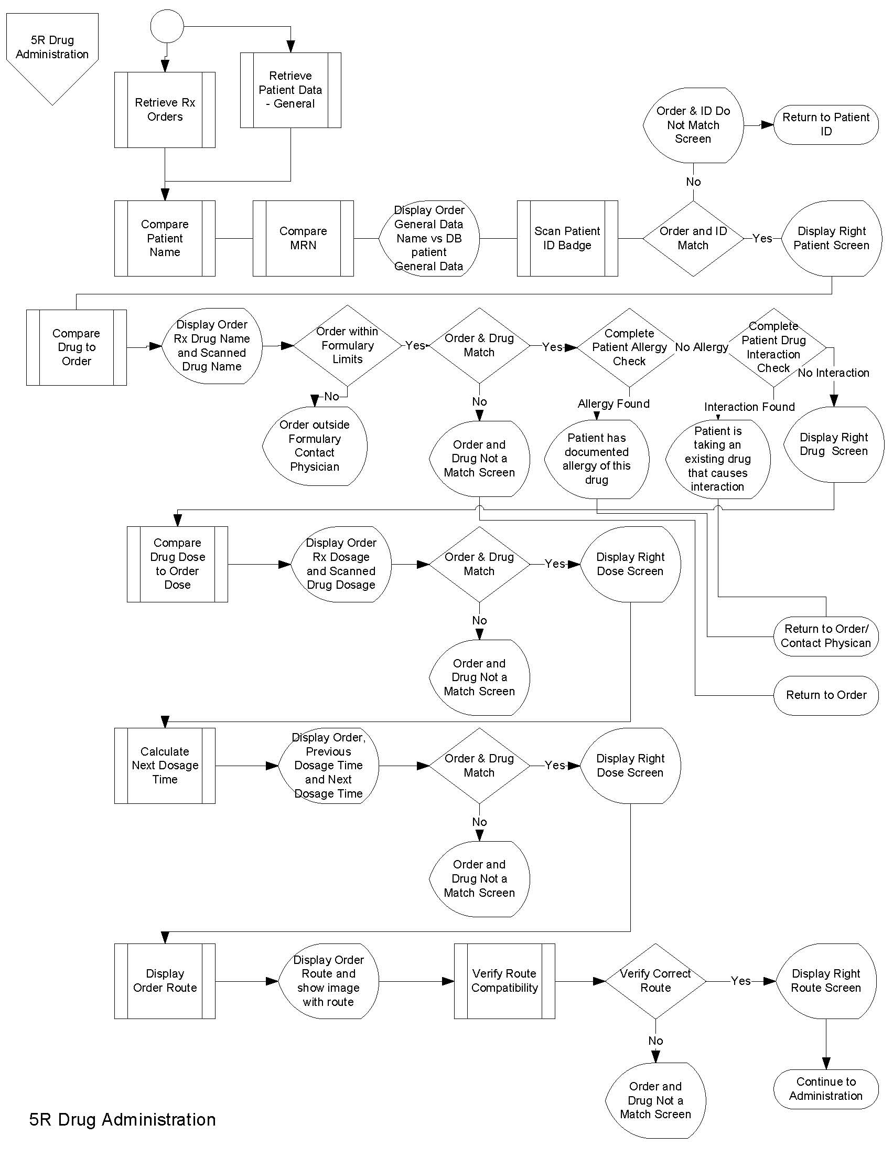
Example of the 5R’s
of Infusion Delivery

Slide 7
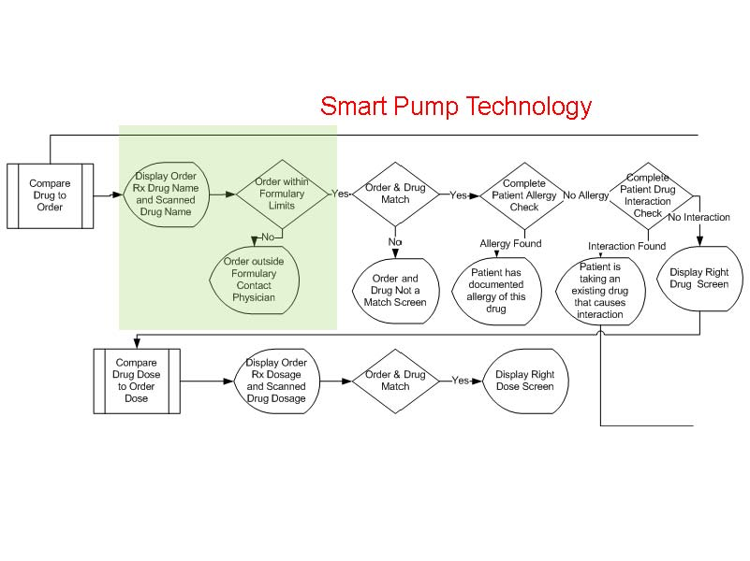

Slide 8
Workflow if patient is on 6 Infusion Pumps
which is not uncommon in the ICU

Slide 9
Current Findings
Contextual Data is required for intelligent systems. This includes:
  Device characteristics
    accuracy,
    Precision
    Source/source characteristics
  Quality of Data
    communication quality
    Data quality
Risk mitigation

